Slide 1
Lab 8
Hash Tables
CS010C

Slide 2
Lab 8: Sentiment Analysis
Sentiment Analysis
Categorizing opinions
Writing mood
Machine Learning
An algorithm that learns
Program will learn from movie reviews
Each review is labeled with a sentiment

Slide 3
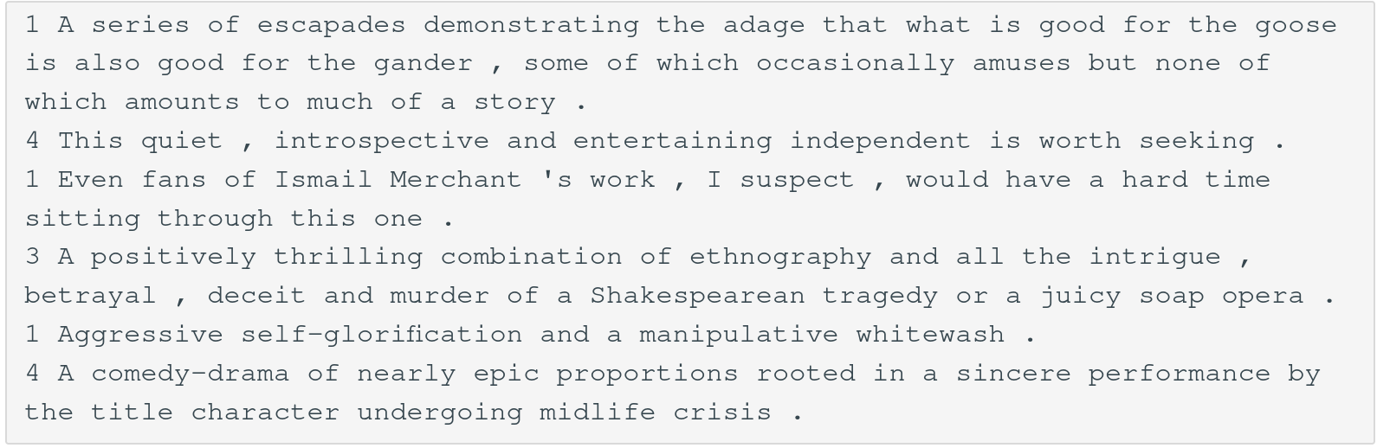
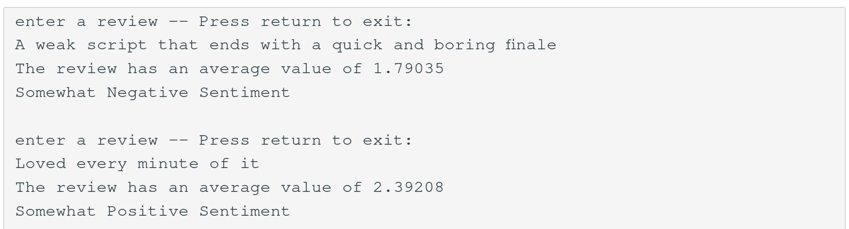
Input:
Output:

Slide 4
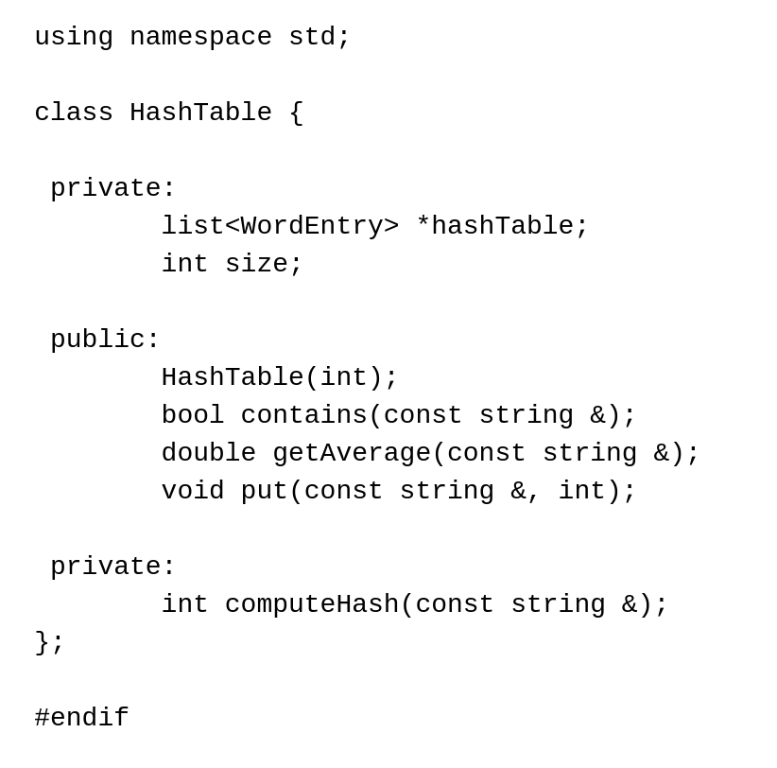
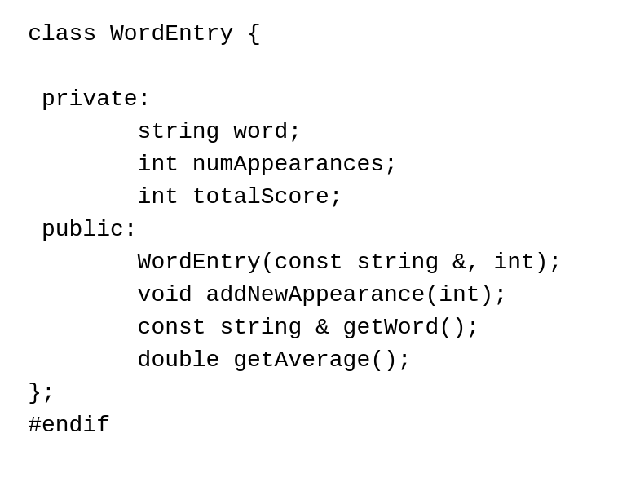
Lab 8: Starter Code
HashTable
list <WordEntry> *hashTable
An array of lists
WordEntry
What you’re storing
Storing:
Word
Number of appearances
Total score

Slide 5
Lab 8: Hash Tables
Data structure to store unordered items
Key used to map to an index
Bucket is the index the object is put into based on the key
A hash function computes which bucket from the key
Collisions occur
Our lab is closed addressing

Slide 6
Lab 8: How the data is stored?
The review text is tokenized into individual words.
Words are normalized (e.g., converted to lowercase).
Each word is stored as a WordEntry object in the HashTable:
If the word exists: Update its totalScore and numAppearances.
If not: Create a new WordEntry with the word and its score.

Slide 7
Lab 8: How to calculate a review sentiment?
The input message is tokenized into individual words
For each word:
Get the average sentiment score from the HashTable using getAverage.
If the word is not found, getAverage returns a neutral score (2.0).
The overall sentiment score is the average of the average scores of all recognized words
The program maps the numerical score to a sentiment category

Slide 8
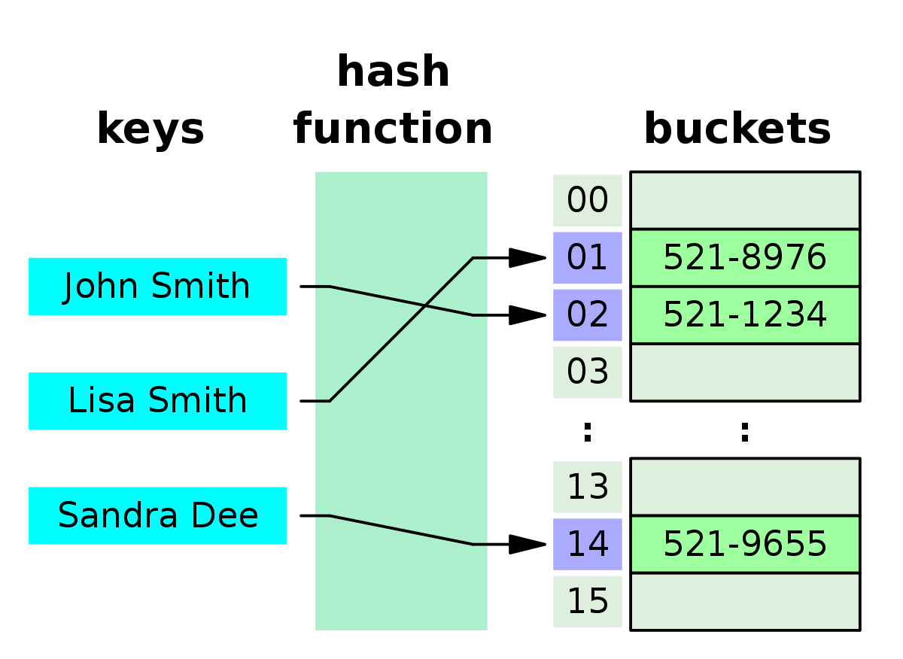

Slide 9
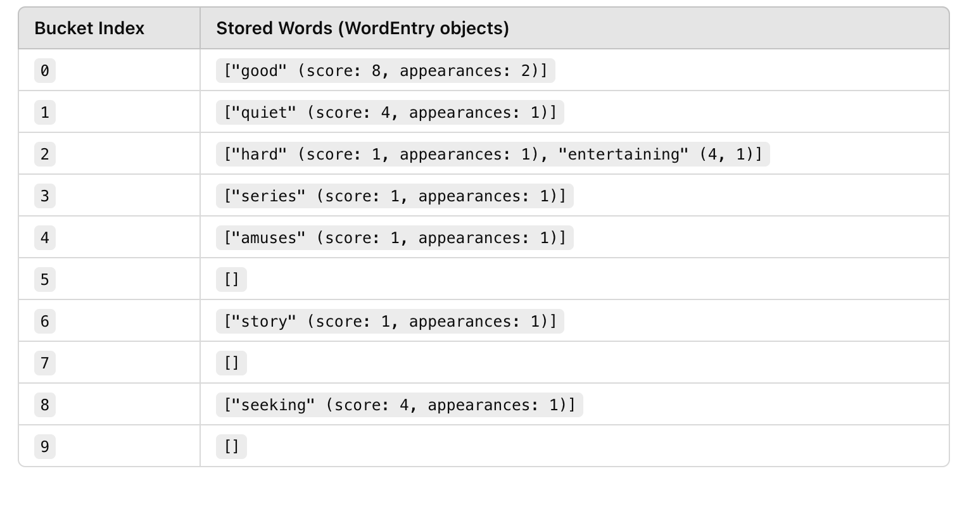

Slide 10
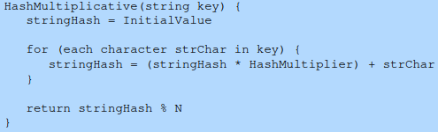
Lab 8: Hash Tables
What makes a good hash function?
Good hash function: Less collisions
The less collisions the better!
Simple hash function:
Add up the value of all characters
Multiplicative string hash function:
Large initial value
Prime hash multiplier
N is hash table size
Multiplicative string hash function

Slide 11
Thank you!
Questions?

